Slide 1

Compliance as Code
Bringing your Compliance team along for the DevOps ride

Slide 2
The take-aways
Help your organisation develop compliant and more secure apps
Avoid delays in shipping software
Reduce attrition and improve collaboration with Compliance

Slide 3
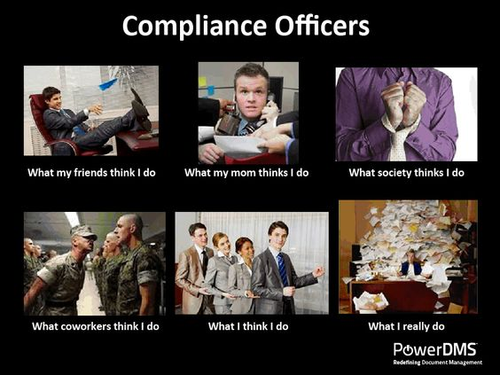

Slide 4
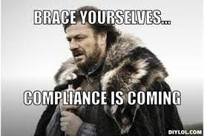

Slide 5
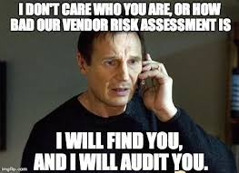
Notes:
You talk about pipelines, yet you’re not plumbers
You talk about containers, yet we’re not a shipping company
You talk about orchestration, yet you’re not maestro’s
All very confusing

Slide 6

What is the state of Compliance in organisations?
‘Fuzzy’ front-end and policies
Spreadsheets and box ticking
Mostly done at end of Dev cycles for major releases
Attrition and last minute
No real understanding of feedback loops
Certainly not ‘sexy’

Slide 7
But do we need it ?

Slide 8
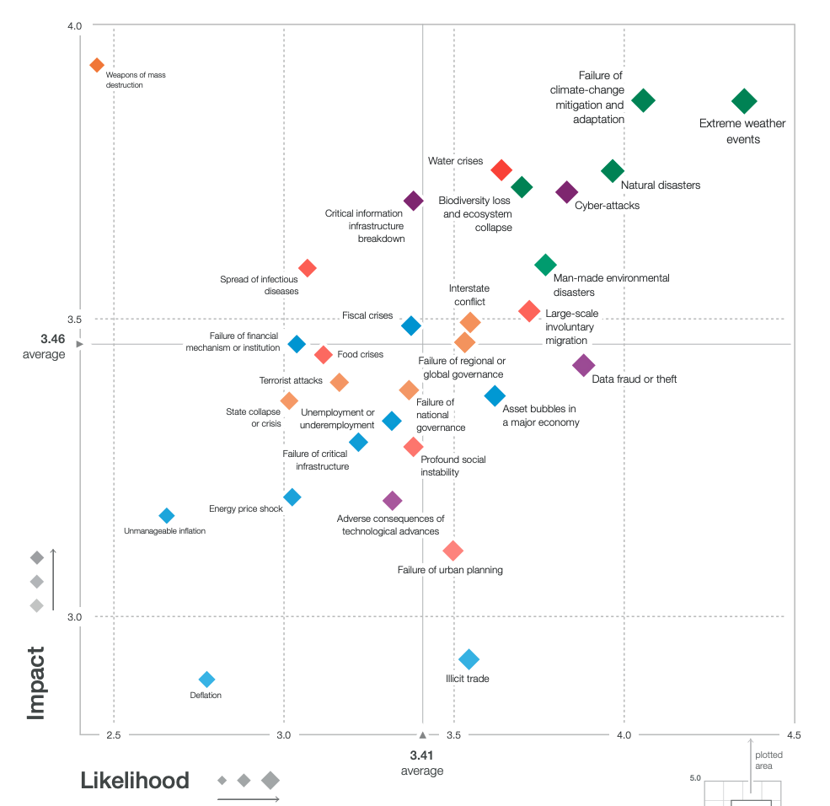
Global Risks Report 2019, World Economic Forum

Slide 9
$3.86M
Average cost of data breach
$148
Average cost per lost or stolen record
2018 Cost of Data Breach Study, Ponemon Institute
Notes:
You talk about pipelines, yet you’re not plumbers
You talk about containers, yet we’re not a shipping company
You talk about orchestration, yet you’re not maestro’s
All very confusing

Slide 10
Security spending
74%
Best practices
69%
Compliance mandates
$124B
Security spend in 2019 (Forbes)
IDG Security Priorities Study
Notes:
If there’s all this spending to achieve compliance, and you don’t really understand what the org policies mean to your coding and testing, how does that help ? How do we ensure our code and pipelines are Setup to achieve to meet those compliance requirements so we don’t have to re-do work ? How do we work together ?

Slide 11
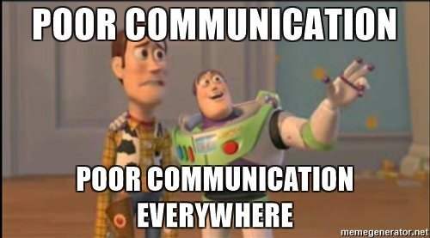
Notes:
First, we acknowledge there’s a comms problem. If your compliance team Works in word documents and spreadsheets, and you work in code and tests then we start there. First we need a common language

Slide 12
‘Compliance as Code’ can be summarised as the organisational capability to automate the implementation, verification, remediation, monitoring and reporting of compliance status.
Notes:
First, we acknowledge there’s a comms problem. If your compliance team Works in word documents and spreadsheets, and you work in code and tests then we start there. First we need a common language

Slide 13
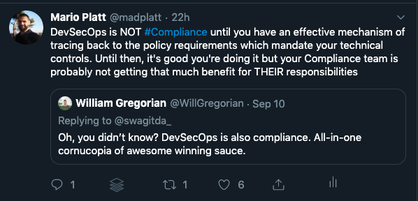
Notes:
First, we acknowledge there’s a comms problem. If your compliance team Works in word documents and spreadsheets, and you work in code and tests then we start there. First we need a common language

Slide 14
Doing ‘Compliance as Code’ means that Compliance requirements are expressed as re-usable code and integrated into DevOps feedback loops
Notes:
First, we acknowledge there’s a comms problem. If your compliance team Works in word documents and spreadsheets, and you work in code and tests then we start there. First we need a common language

Slide 15
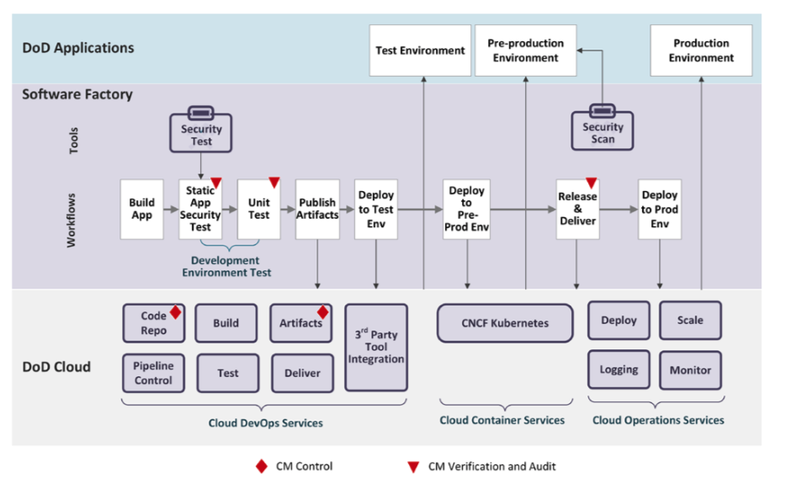
Control reliance is different
Notes:
First, we acknowledge there’s a comms problem. If your compliance team Works in word documents and spreadsheets, and you work in code and tests then we start there. First we need a common language

Slide 16
Pitching at the right level ?
Exec Level communication
Overall Cyber Security Frameworks
Detail-Oriented Controls
NIST
COBIT
HIPAA
ITIL
PCI DSS
ISO 27001:2013 ISMS
OWASP Top 10 & CheatSheets
CIS Benchmarks
Vendor hardening guidelines
ASVS
Adapted Security control frameworks and industry standards, CISO Compass

Slide 17
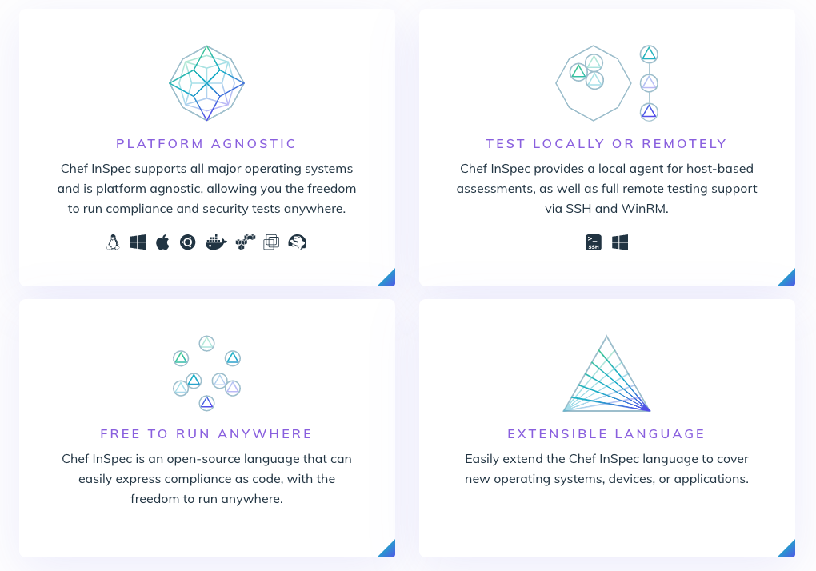
Inspec.io

Slide 18
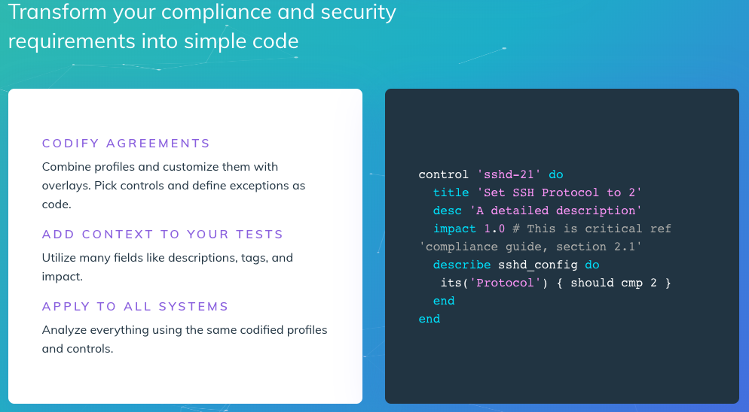
Inspec.io

Slide 19
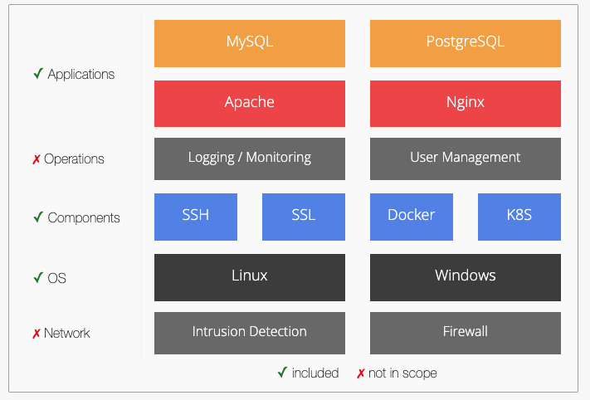
Dev-sec.io

Slide 20
Enables developing policy by actually understanding operational implications

Slide 21
Helping your Compliance team

Slide 22


Understanding what they’re on about
Requirements
Implementation
V3: Session Management Verification
Session Management Cheat Sheet
Notes:
Will provide info on Session ID fingerprinting, lenght, ID entropy, content and others

Slide 23
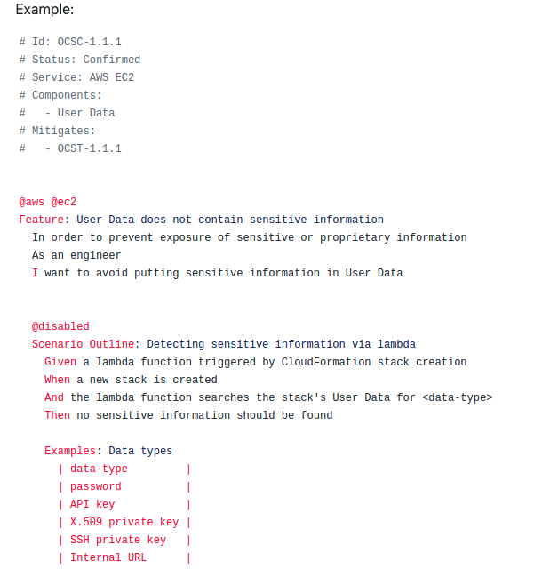
Control stories

Slide 24
Top Tips
Software ate the world. Some didn’t get the memo
Many may feel inadequate. Empathy goes a long way
Training and change support will be required
Traceability is key
Write stories (the Agile kind)

Slide 25
The take-aways
Help your organisation develop compliant and more secure apps
Avoid delays in shipping software
Reduce attrition and improve collaboration with Compliance

Slide 26

Questions ?
Mario.Platt@privacybeacon.io
Twitter: @madplatt
LinkedIn: /in/marioplatt/
Medium: https://medium.com/@marioplatt

